Slide 1
Chapter 1
Introduction

Slide 2

What do you want to be when you grow up?
Source: https://steemkr.com/steemiteducation/@oluwoleolaide/what-do-you-want-to-become-when-you-grow-up-a-void-question-in-my-country
Notes:
Unlimited wants
Why can’t we achieve all of them?

Slide 3
Fundamental problem
Unlimited wants
Limited resources
Scarcity
Society’s resources are limited – time, air, land
Scarcity forces us to make choices
Economics helps us to make decisions

Slide 4
Choices
Because of scarcity – we must make choices
Why choices?
To fulfil
Needs: Things we must have to survive
Food, Shelter, Clothing
Wants: Things we would really like to have
Jewelry, Expensive car

Slide 5
Economics definition
Economics is the study of how people make choices to satisfy their unlimited wants with scarce resources

Slide 6

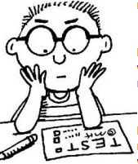

Trade-offS
You cannot have it all
So, you have to pick one thing from all other possibilities
Vs.
Vs.
Notes:
Source: https://en.facebookbrand.com/assets/f-logo
Source: https://www.logotaglines.com/flipkart-logo-and-tagline/
Source: https://www.mind-expanding-techniques.net/studying-techniques.html

Slide 7
Opportunity Cost
Any choice has a cost
Opportunity Cost is the value of the next best thing
For example: You decided to do Facebook for an hour
What is the opportunity cost of Facebook?
Reading this chapter twice
Additional hour of Sleep
If worked you could earn Rs.50/hour
Made some purchase

Slide 8

Shortage is not Scarcity
Shortage is not same as scarcity
Shortage: short period of time when an item cannot be purchased
Examples
Shortage of water in Chennai
Shortage of women CEOs in Fortune 500

Slide 9
Economic Ideas
People are rational
People respond to economic incentives
Optimal decisions are made at the margin

Slide 10
Rationality
People are rational
Do you intentionally buy stale food?
Example – buying a car
Extensive research
Evaluation of alternatives
Purchase decision

Slide 11
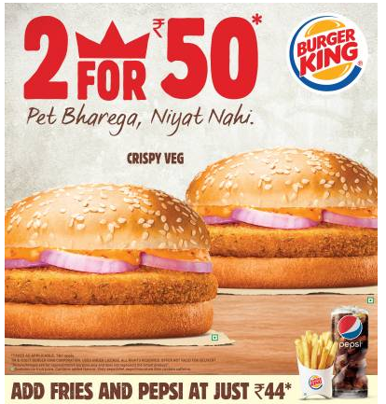
Economic Incentives
An incentive is a motivator to get someone change his/her behavior
Source: www.adgully.com/burger-king-offers-a-double-dose-of-taste-with-its-new-value-offering-73498.html

Slide 12
Marginal Decisions
When making decisions
Marginal Benefit (MB) should be compared to Marginal Cost (MC)
Choice is rational if MB > MC
Example:
MB: By studying Economics for one more hour will increase Economics test score by 5 points
MC: Studying Math instead of Economics will help increase Math score by 4 points
If you decide to study Economics, then 5 points are more valuable than 4 points

Slide 13
Three Economic Questions
Unlimited wants
Limited resources
Scarcity
Choices
What to produce?
How to produce?
For whom to produce?

Slide 14
Types of Economies
Economy | Definition | Example
Planned
Government decides on what, how, and for whom
Cuba, China, Laos
Mixed
Individuals, firms, and government decides on what, how, and for whom
U.S.A., U.K., Japan
Market
Individuals and firms decide on what, how, and for whom
Hong Kong

Slide 15
Market System
Market: A place where buyers and sellers meet
Two groups: Households and Firms
Market (types): Factor and Product
Factor markets: Factors of production are sold by households to the firms
Product markets: Any good or service sold by the firms and purchased by the households

Slide 16
The Circular- Flow Diagram
Revenue
Spending
Product Markets
Goods & Services sold
Goods & Services bought
Firms
Households
Factors of production
Labor, land, capital
Factor Markets
Wages, rent, profit
Income

Slide 17
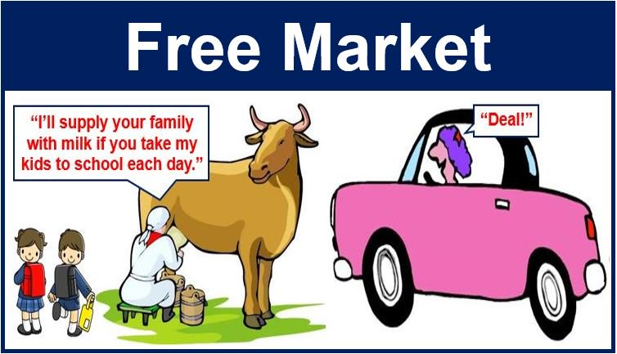
Free Market
Individuals are acting on their own rational self-interest
“Invisible hand”

Slide 18
Efficiency
Market economies are better than planned economies because of
Productive Efficiency – Producing goods and services in the least costly way
Allocative Efficiency – Producing goods wanted by the society

Slide 19
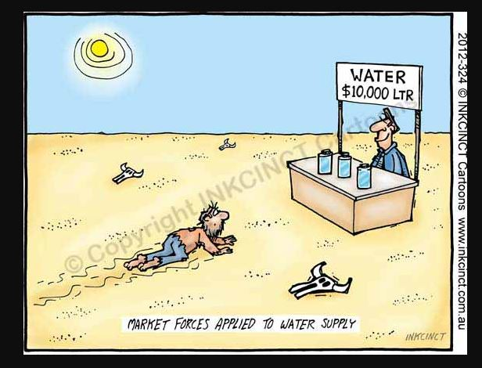
Market Failure
Market outcomes are not always efficient
Government might interfere

Slide 20
Government Intervention
Price Ceiling
Maximum price that sellers can charge
Example: Rent control
Government sets a maximum house rent that can be charged
Price Floor
Minimum price set by the government
Example: Minimum Wage
Minimum legal wage that employer have to pay their employees

Slide 21


Microeconomics vs MAcroeconomics
Micro
Macro
Source: https://creativemarket.com/blog/getting-started-with-micro-ux-a-simple-guide-5-fascinating-examples
Notes:
Microeconomics: Decisions made by the individual and business. Price determination, Production and Cost, Consumer behavior.
Macroeconomics: Concerned about the whole economy. For example GDP, Inflation, Unemployment.

Slide 22
Examples of micro and macroeconomic concerns
 | Production | Prices | Income | Employment
Micro economics | Production/Output in Individual Industries and Businesses How much steel How many offices How many cars | Price of Individual Goods and Services Price of medical care Price of gasoline Food prices Apartment rents | Distribution of Income and Wealth Wages in the Industry A Minimum wages Executive salaries | Employment by Individual Businesses & Industries Jobs in the steel industry Number of employees in a firm
Macro economics | National Production/Output Total Industrial Output GDP | Aggregate Price Level Consumer prices Producer Prices Rate of Inflation | National Income Total wages and salaries Total corporate profits | Employment and Unemployment in the Economy Total number of jobs Unemployment rate

Slide 23
Economics: Definition
The term Economics originates from the Greek words: oikos (house) and nomos (custom or law)
Means “Laws of Households”
Economics is thus defined as a body of knowledge or study that discusses how society tries to solve the human problems of unlimited wants and scarce resources.
As per Adam Smith “Economics is the science of wealth of nations”--- Wealth definition
As per Alfred Marshall “Economics is the study of mankind in the ordinary business of life”--- Welfare definition
As per Robbins “Economics is a science which studies human behaviour as a relationship between ends and scarce means which have alternative uses”--- Scarcity definition

Slide 24
Books
Principles of Economics, N. Gregory Mankiw, South Western (2012), 6th Ed.
Macroeconomics (Theory and Policy), D N Dwivedi Tata Mcgraw Hill (2010) 3 Ed.
Macroeconomics, R Dornbusch, Fisher, and R Startz, Tata-Mcgraw Hill (2012), 10th Ed.
Principles of Economics, Case, Fair and Oster, Pearson 11 edition (2014)

